Slide 1
Before the workshop starts please:
1. Download R :
https://www.r-project.org/
2. Download Rstudio Desktop (Open Source License):
https://www.rstudio.com/products/rstudio/download/
3. Download the workshop materials:
https://umd.box.com/v/Rworkshop2017

Slide 2
Introduction to Data Wrangling with R
David Ampofo
Carolyn Maurer

Slide 3
What Is R?
Open source programming language and software environment
Based on S programming language
R was created by Ross Ihaka and Robert Gentleman at the University of Auckland, New Zealand, and is currently developed by the R Development Core Team

Slide 4
Why Use R?
Free
Great interface from data wrangling
Powerful in statistical computation and graphical visualization
Have all capabilities of a stand alone software(SPSS, SAS), but includes additional add-ons in R packages
Increasing popularity in academia and business

Slide 5
Outline: Using R, Step by Step
1. Setting up
Set working directory
2. Import Data
Check console for errors
Check object to see if it looks correct
3. Manipulate Data
Subset or sort data if needed
Summary statistics for the whole data or for subgroups
4. Plot Data
Examine the formats and names of columns, rename columns if needed
Open Rstudio
Histogram
5. Data Analysis
Run statistical tests
Open existing or create a new R script
Plot

Slide 6
5 basic atomic classes
 | Class | Example
1 | Integer | 3L as.integer(3)
2 | Numeric | Real or Decimal: 3 3.0 pi
3 | Character | “a”, “b”, “University of Maryland”
4 | Logical | TRUE FALSE
5 | Complex | 1 + 4i
How to know the class?
class()
is.numeric() is.character() is.logical()
How to change the class?
as. numeric()
as.logical()
as.character()

Slide 7
5 basic atomic classes
 | Class | Example
1 | Integer | 3L as.integer(3)
2 | Numeric | Real or Decimal: 3 3.0 pi
3 | Character | “a”, “b”, “University of Maryland”
4 | Logical | TRUE FALSE
5 | Complex | 1 + 4i
How to know the class?
class()
is.numeric() is.character() is.logical()
How to change the class?
as. numeric()
as.logical()
as.character()

Slide 8
5 basic atomic classes
 | Class | Example
1 | Integer | 3L as.integer(3)
2 | Numeric | Real or Decimal: 3 3.0 pi
3 | Character | “a”, “b”, “University of Maryland”
4 | Logical | TRUE FALSE
How to know the class?
class()
is.numeric() is.character() is.logical()
How to change the class?
as. numeric()
as.logical()
as.character()
Notes:
For our purposes we will not really need to ever worry about the complex class because it is typically used in higher mathematics and other languages

Slide 9
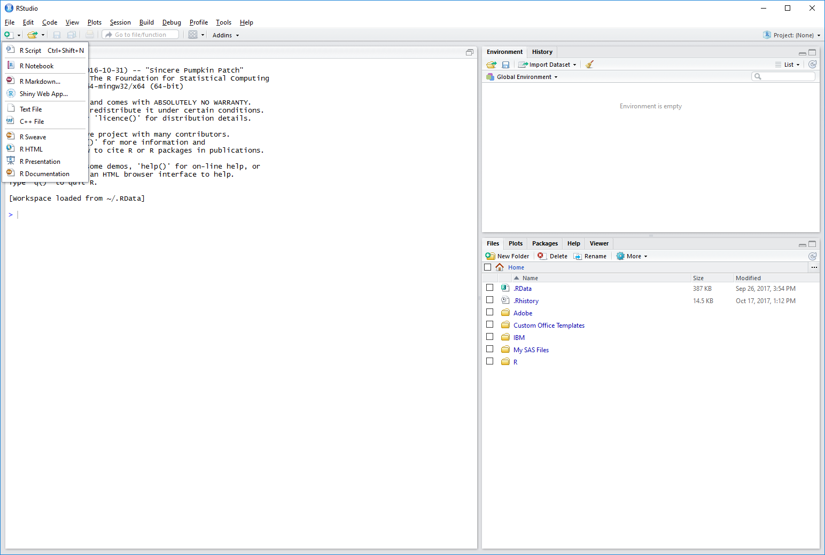
Get started…
Why Using R Script rather than inputting commands in the console directly?
To save your codes for later reference and usage
Easy to edit

Slide 10

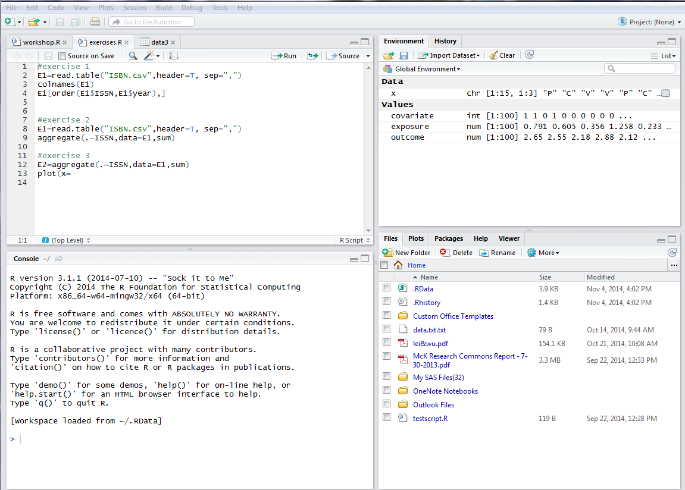
Basic Editor Elements (of Rstudio)
Source editor: Text editor for scripts.
Objects: names, properties, and variables
Library: File manager, plots, help files
Console: Execute code and examine the log.
-- Can also type commands here too!
Notes:
Open up R now on your computer
Explain elements
Scripts versus command line
Windows: Crtl + R to run a highlighted line

Slide 11
Get Started…
Assign values to a variable
x <- 3
x = 1:3
x <- c(1, 3, 7)
y <- c(“a”, “b”, “c”)
z <- c(x, y)
Use R as a calculator
35*40/4 =?
sqrt(4) =?
9**2 = ?
Notes:
What will I get if I ask R to perform this multiplication problem? Show them that if I assigned the multiplication above it will equal Multiplication = 35*40/4

Slide 12
Get Started…
Assign values to a variable
x <- 3
x = 1:3
x <- c(1, 3, 7)
y <- c(“a”, “b”, “c”)
z <- c(x, y)
Use R as a calculator
35*40/4 =350
sqrt(4) =?
9**2 = ?
Notes:
What will I get if I ask R to perform this multiplication problem? Show them that if I assigned the multiplication above it will equal Multiplication = 35*40/4

Slide 13
Get Started…
Assign values to a variable
x <- 3
x = 1:3
x <- c(1, 3, 7)
y <- c(“a”, “b”, “c”)
z <- c(x, y)
Use R as a calculator
35*40/4 =350
sqrt(4) =2
9**2 = ?
Notes:
What will I get if I ask R to perform this multiplication problem? Show them that if I assigned the multiplication above it will equal Multiplication = 35*40/4

Slide 14
Get Started…
Assign values to a variable
x <- 3
x = 1:3
x <- c(1, 3, 7)
y <- c(“a”, “b”, “c”)
z <- c(x, y)
Use R as a calculator
35*40/4 =350
sqrt(4) =2
9**2 = 81
Notes:
What will I get if I ask R to perform this multiplication problem? Show them that if I assigned the multiplication above it will equal Multiplication = 35*40/4.

Slide 15
Hints:
R is case sensitive
Comment in your codes: #
Get help:
?
??
help()

Slide 16
In this section you will learn how to:
Install a package
Library a package
Import data

Slide 17
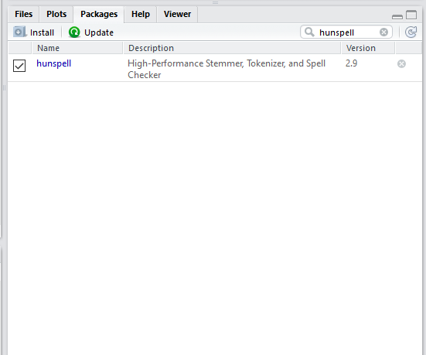

Installing a package
Method 1 search for the package name in the library
Method 2 (Recommended)
install.packages(“packagename”)
Example:
Type and run in the console
install.packages("hunspell")

Slide 18
Librarying a package
library(packagename)

Slide 19
Import dataset
Method 1:
Point and Click:
In the Environment tab in the Top right click “Import Dataset”
From the drop-down menu click on the file extension type (i.e. CSV, Excel, etc)
In the File/Url window click “Browse” and find the file on your computer
Click “Import”
Method 2:
Setting working directory:
setwd(“folder path”)
read.csv(“relative file path”)
Method 3:
Directly inputting the full path:
read.csv(“full path”)
R uses Forward Slash “/” in the directory path: C:/Users/R workshop
For Mac users, you can just copy and paste the path.
For Windows users, you need to change all the back slash to forward slash
Notes:
Different ways to so tomato

Slide 20
Exercise 0
length(dataframe$ColumnofData)
Finds or sets the length of a vector or factor
table(x) Creates a table
Builds a contingency table of the counts at each level of x
max(x, na.rm = TRUE)
Finds the maximum value of x
min(x, na.rm = TRUE)
Finds the minimum value of x
mean(x, na.rm = TRUE)
Finds the mean of x
median(x, na.rm = T)
Finds the median of x
sum(x, na.rm = T)
Finds the sum of x
var(x, na.rm = T)
Finds the variance of x
sd(x, na.rm = T)
Finds the standard deviation of x
Notes:
Basic Commands

Slide 21
In this section you will learn how to:
Examine a data frame
Subset a data frame
Produce a summary report

Slide 22
Examining the dataset
View() To view data (or just click it in the environment)
dim() Get dimensions - how many observations of how many variables(or just look at the data in the environment)
head() The top few rows of a variable
nrow() Number of rows
ncol() Number of columns
colnames() The name of the column
rownames() The name of the row
str() Compactly displays the structure of an arbitrary R object
unique() The unique observations in a column
codebook() Generate a codebook of a data set
Complete.cases() Show me the complete observations in a dataset

Slide 23
Subsetting data
1. Subset by row and/or column index
DATA [ROW, COLUMN]
data[1, ]
data[, 2]
data[1,3]
2. Subset by variable name
DATA$VARIABLE_NAME
data$id
3. Subset by specific criteria
DATA[which(), ]
data[which(data$variable > 1000), ]
data[which(data$sex == “Male”), ]

Slide 24
Summary report
Summary of each of the variables : summary()
Summary statistics for subgroup
Example question: According to this ACLED data, what is the average fatality by event type?
aggregate(ACLED_df$fatalities, by= list(ACLED_df$event_type), mean)
Which variable’s statistics?
What subgroup?
How?
mean, sum, max …

Slide 25
Exercise 1
How many fatalities occurred by event type and year?
Using actor1 how many fatalities were the Unidentified Armed Group (Palestine) involved in?
Which day had the most fatalities?

Slide 26
In this section you will learn how to:
Recode data
Sort data

Slide 27
Recoding columns and rows
Renaming all the columns:
colnames(data) <- c(“a", “b", "c", “d", “e")
Renaming only one of the columns:
colnames(data)[2] <- “gender“
Renaming one of the rows
rownames(data)[1] <- “first row”
Notes:
Remember script is linear so first we are calling all the column names of the data then we are specifying of these colnames I want the 2 name to be reassigned the string gender

Slide 28
Recoding
# Replace all the data in a field with a number
Data$Grade <- 5
# Replace all the data in a field with with text
Data$Grade <- "Five"
# Replace all the data in a field with NA (missing data)
Data$Grade <- NA

Slide 29
Recoding
# Replace the data in a field based on equal to some value
Data$Grade[Data$Grade==5] <- "Grade Five"
# Or replace based on greater than or equal to some value
Data$Grade[Data$Grade<=5] <- "Grade Five or Less"
# Or replace based on equal to some text
Data$Grade[Data$Grade=="Five"] <- "Grade Five"
# Or replace only missing data
# Note that ==NA does not work!
Data$Grade[is.na(Data$Grade)] <- "Missing Grade"

Slide 30
Sort dataset
DATA[order(Variable_name), ]
data[order(data$variable), ]
data.sorted <- data[order(data$var1,data$var2), ]
Example: ACLED_df<- ACLED_df[order(ACLED_df$event_type, ACLED_df$fatalities), ]

Slide 31
Exercise 2
Rename the column “source” to “opinion”
Sort the dataset by “opinion” and “year”
Recode all ‘BBC’ observations to ‘BritishBeingCool’

Slide 32
In this section you will learn how to:
Read documentation
Check for spelling errors in data

Slide 33
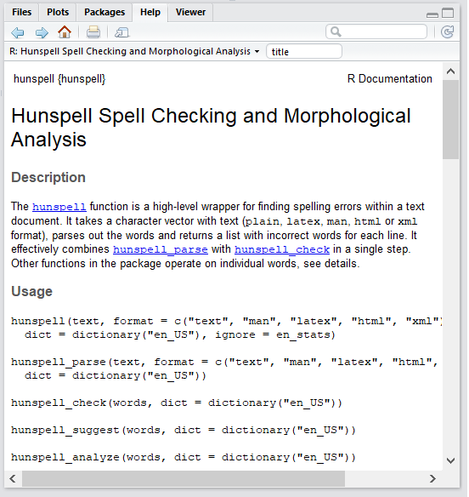
Hunspell
Library(hunspell)
?hunspell
Package ‘Help’ pages have the following:
Description
Usage
Arguments
Details
Example (If you are lucky)
Notes:
Arabic or other langu
Darii
russian

Slide 34
Hunspell functions
hunspell_check(words)
Checks individual words
hunspell_find(“A buncha of words”)
Takes a character vector with text (in plain, latex or man format) and returns a list with incorrect words for each line.
hunspell_suggest(words[!correct])
Suggests words for the incorrect bunch of words

Slide 35
Exercise 3
Read the documentation for any of the packages we have installed for today and give everyone its:
Description
Usage
Example

Slide 36
In this section you will learn how to:
Merge data frames
Choose when and what to plot
Plot data

Slide 37
Merging data frames
Merged Data frame = Data Frame 1 + Data Frame 2
Merged_dataframe <- Rbind(DataFrame1, DataFrame2)
Read in 2018-04-12-2018-08-01-Middle_East-Israel-Palestine.csv as ACLED_df_2
Merged_ACLED_df <- rbind(ACLED_df, ACLED_df_2)

Slide 38
Bivariate Graph – scatterplot
plot(x, y,
main = "Your title",
xlab = "Title for x axis",
ylab = "Title for y axis")

Slide 39
Univariate plot: Histogram
hist(x,
main = "Your title",
xlab = "Title for x axis")
Notes:
-have examples where there are comments prompoting a fill in the blank like datacamp

Slide 40
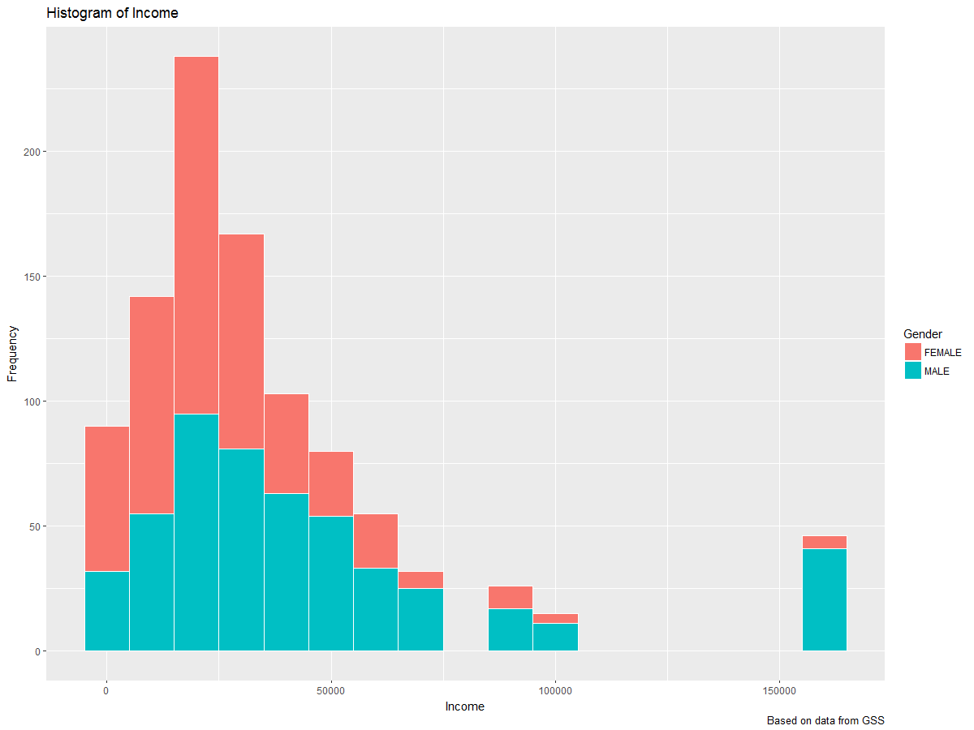
More complex graph – ggplot Histogram with Fill
Install package
install.packages(“ggplot2”)
Use the package
library("ggplot2")
Use the ggplot function
ggplot (data, aes(x= )) + geom_histogram ()

Slide 41
ggplot + geom_histogram
ggplot: Define the dataset, x, variables
geom_: The graph type and format
ggplot(data, aes(x= , fill = )) + geom_histogram(binwidth =, color = “”, )
Fill: which variable to compare inside the bar
binwidth: the width of one bar
color: the color of bar boundary

Slide 42
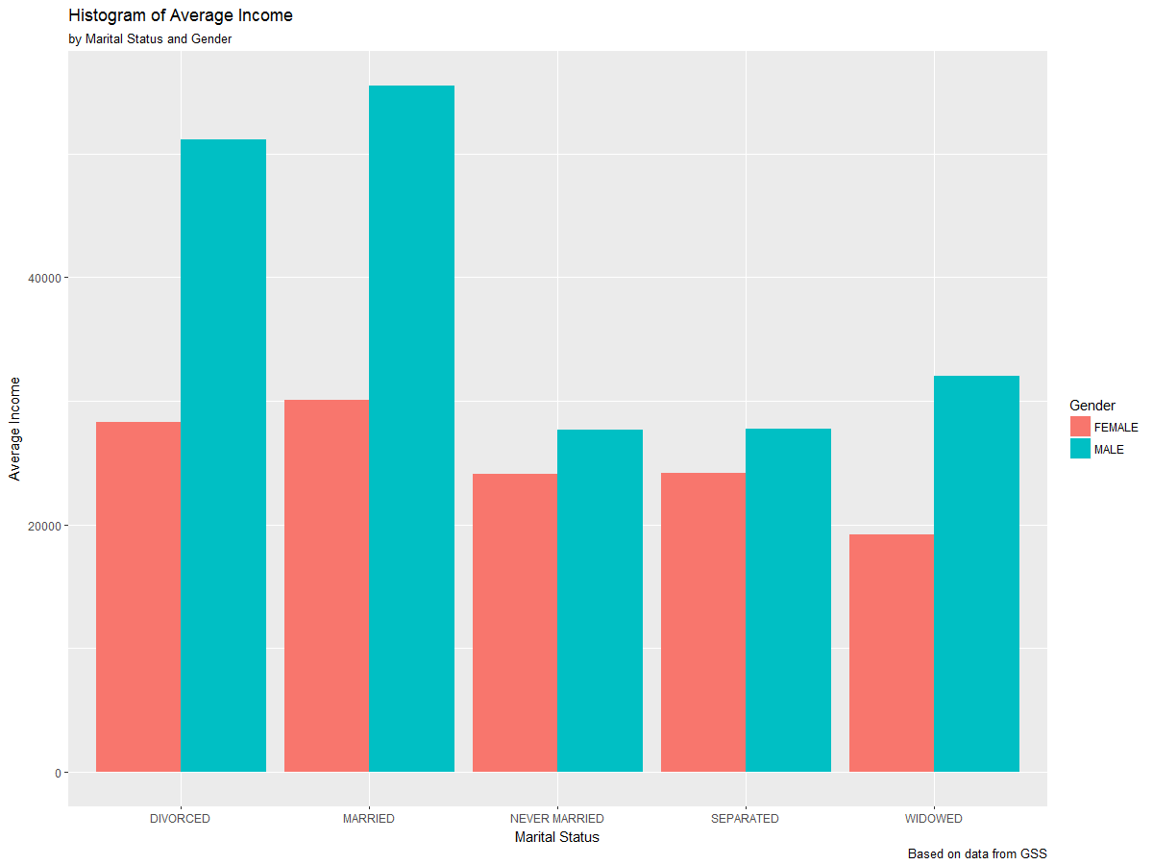
More complex graph – ggplot Plot the summary data
Install package
install.packages(“ggplot2”)
Use the package
library("ggplot2")
Use the ggplot function
ggplot (data, aes(x=, y=, fill= )) + geom_bar (position = "dodge", stat="identity")

Slide 43
Exercise 4
Subset the data by one variable
Plot something and make it look cool

Slide 44
In this section you will learn how to:
Perform a
Multiple
Linear
Regression

Slide 45
Simple Linear Regression
y = β₀ + β₁x + e
y: dependent variable
x: independent variable
e: error term
β₀: intercept
β₁: slope for predictor 1
Notes:
-There is an x and there is a y. We have to use theory, evidence, and logic to form proper
understanding of the data. Even if we are not analyzing it we should always keep in mind what the data means
in the greater context.

Slide 46
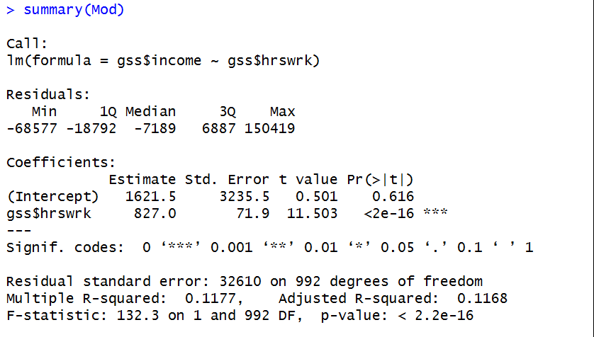
Simple Linear Regression
①: F test p value:
If this model is statistically significant
②: R squared:
how much variance in Y can be explained by the variance in X
③: Intercept
④: Slope
③
④
②
①

Slide 47
Exercise 5
Using the undergraduate subset dataset created in Exercise 3
Run a multiple linear regression of:
fatatlities(dependent variable, Y) on
country_type (independent variable, X1) and
event_type (independent variable, X2)
Using the regression output, write down the regression model as a comment in your code
Is the model significant on alpha = 0.05?

Slide 48
Outline: Using R, Step by Step
1. Setting up
Set working directory
2. Import Data
Check console for errors
Check object to see if it looks correct
3. Manipulate Data
Subset or sort data if needed
Summary statistics for the whole data or for subgroups
4. Plot Data
Examine the formats and names of columns, rename columns if needed
Open Rstudio
Histogram
5. Data Analysis
Run statistical tests
Open existing or create a new R script
Plot

Slide 49
Thank You

